Slide 1
Hooligan 2
By Rev Guarino

Slide 2

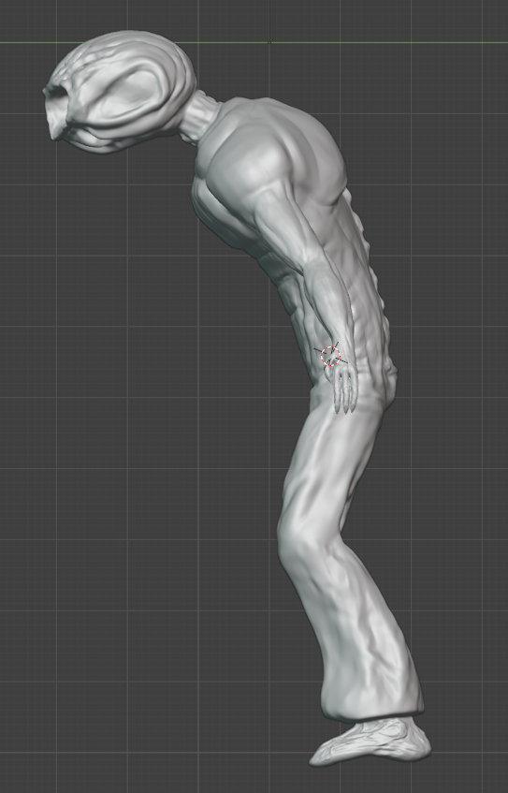
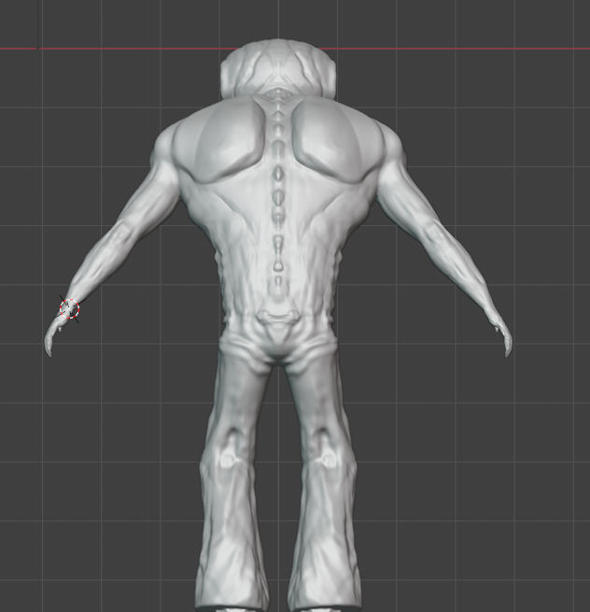

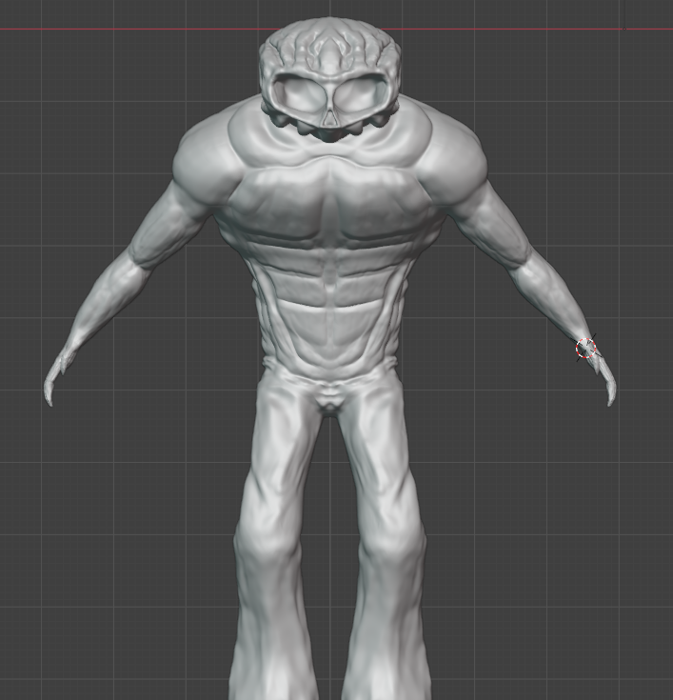
Sculpted Model

Slide 3
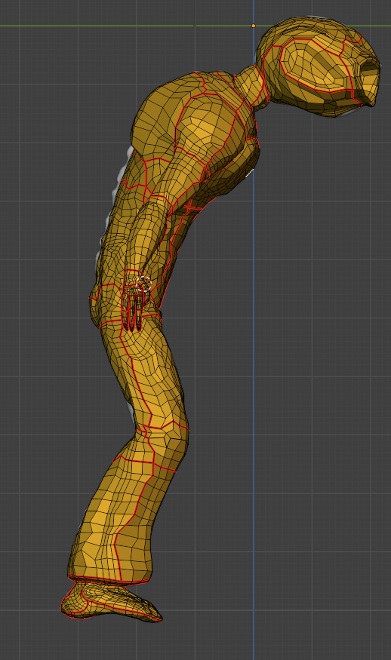
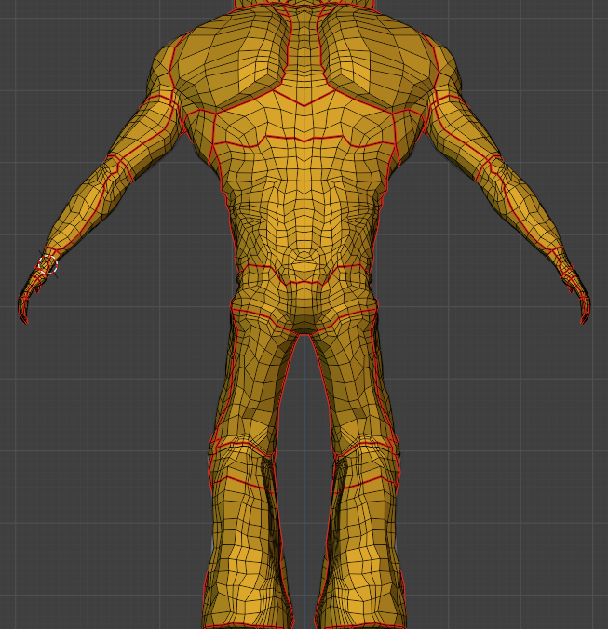
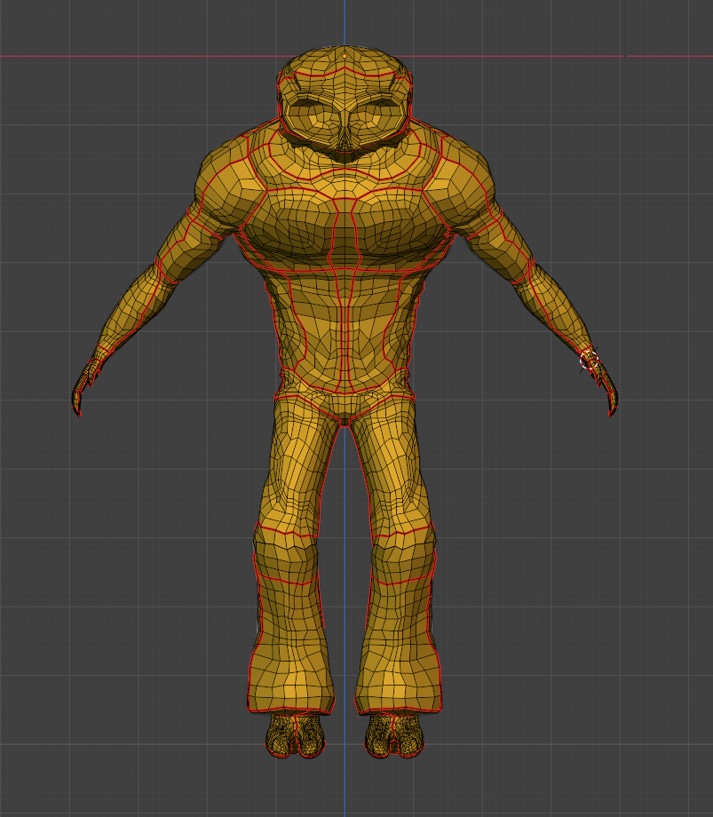
Mesh and Seams

Slide 4
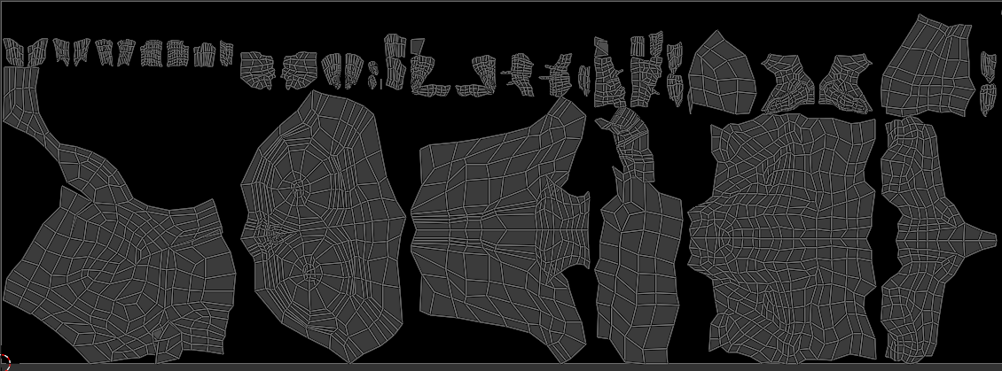
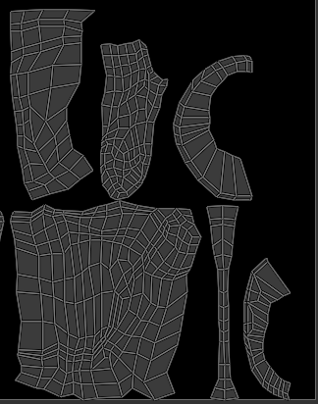
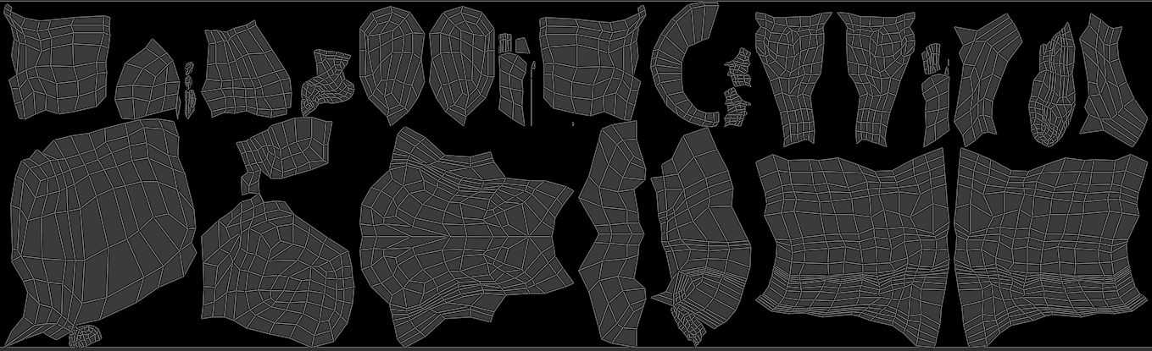
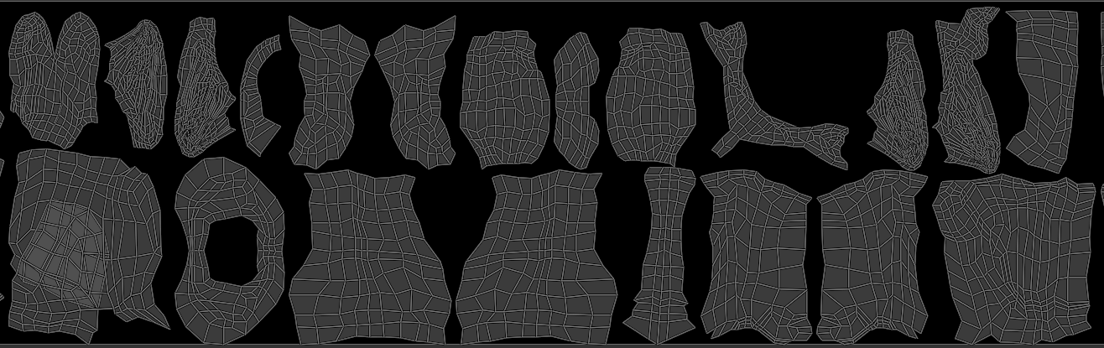
UV (Pile of Woe)

Slide 5
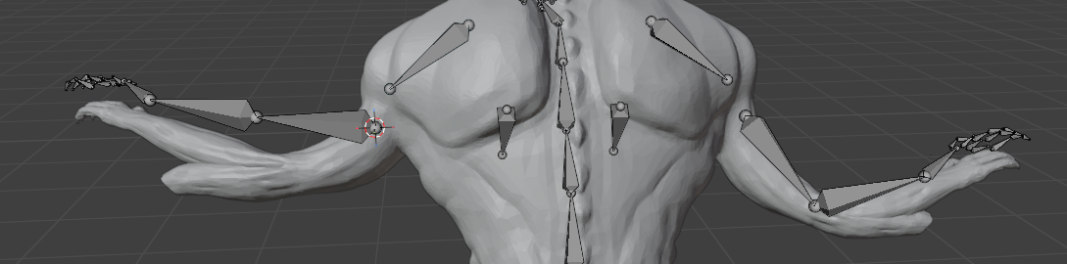
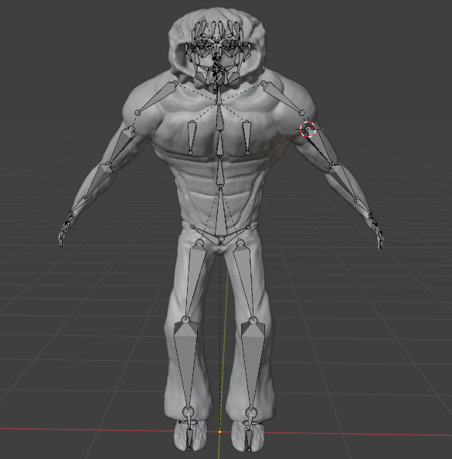
Rig Progress (Oof)
Ran into a lot of problems with bones moving waaaaaay too much of the model.
Made worse by a problem in my mesh. At one point I cut and changed the hands I had after they had been joined and apparently didn’t connect the edges?
Haven’t started on face yet, and have no plan of attack for that yet.

